Slide 1
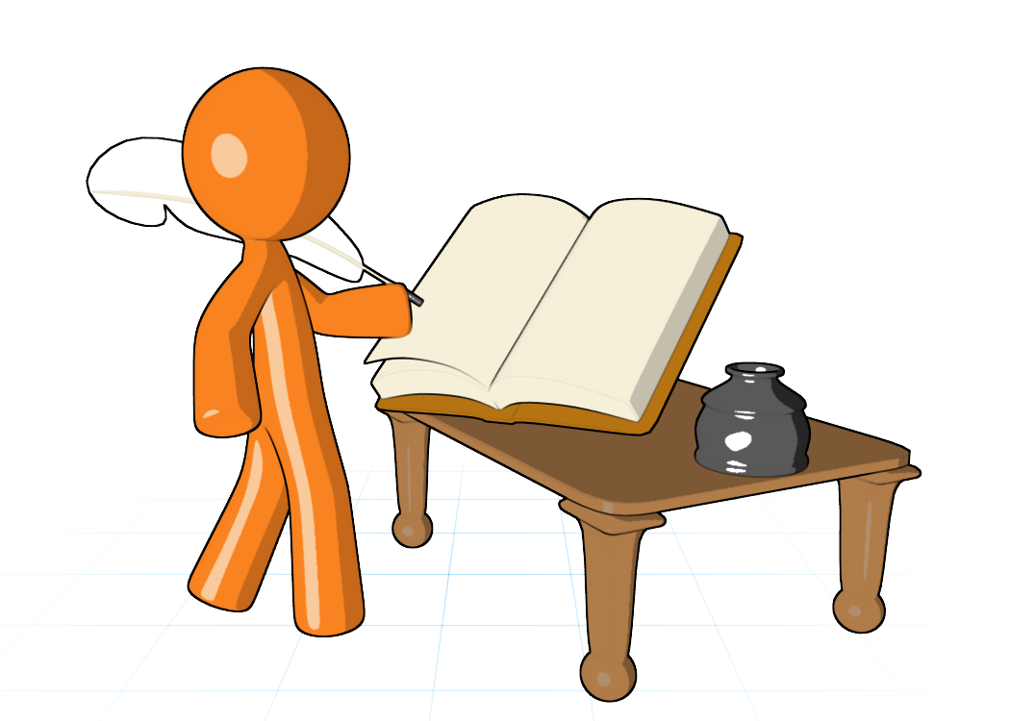
New Section
Information Technology Infrastructure
Part
2

Slide 2
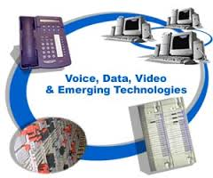
IT Infrastructure and Emerging Technologies
Chapter 5
MFIS
Lisa Murphy
Notes:
2

Slide 3
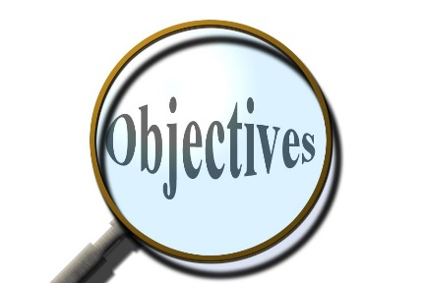
Learning Objectives
To gain an understanding of the following:
Define IT infrastructure and describe its components.
Identify and describe the stages and technology drivers of IT infrastructure evolution.
Assess contemporary computer hardware platform trends.
Assess contemporary software platform trends.
Evaluate the challenges of managing IT infrastructure and management solutions.

Slide 4

Cars.com’s IT Infrastructure Drives Rapid Business Growth
Problem: Aggressive growth plans hampered by outdated technology.
Solutions: Replaced entire IT infrastructure to allow the company to keep pace with its quick expansion.
IBM’s WebSphere application server and Rational software led to reduced costs and increased productivity.
Demonstrates IT’s role in fostering the growth of a business.
Illustrates IT infrastructure’s importance to a developing company.

Slide 5
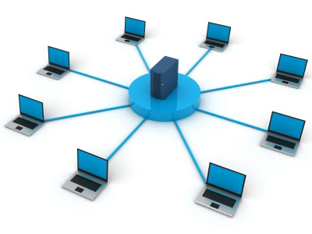
IT Infrastructure
Defining IT infrastructure:
Set of physical devices and software required to
operate enterprise
Set of firmwide services including:
Computing platforms providing computing services
Telecommunications services
Data management services
Application software services
Physical facilities management services
IT management, standards, education, research and development services
“Service platform” perspective more accurate view of value of investments

Slide 6
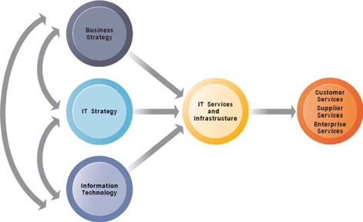
Connection Between the Firm, IT Infrastructure, and Business Capabilities
The services a firm is capable of providing to its customers, suppliers, and employees are a direct function of its IT infrastructure. Ideally, this infrastructure should support the firm’s business and information systems strategy. New information technologies have a powerful impact on business and IT strategies, as well as the services that can be provided to customers.

Slide 7
Evolution of IT infrastructure
General-purpose mainframe and minicomputer era: 1959 to present
1958 IBM first mainframes introduced, eventually used to support thousands of online remote terminals
1965 less expensive DEC minicomputers introduced, allowing decentralized computing
Personal computer era: 1981 to present
1981 Introduction of IBM PC
Proliferation in 80s, 90s resulted in growth of personal software
Client/server era: 1983 to present
Desktop clients networked to servers, with processing work split between clients and servers
Network may be two-tiered or multitiered (N-tiered)
Various types of servers (network, application, Web)

Slide 8
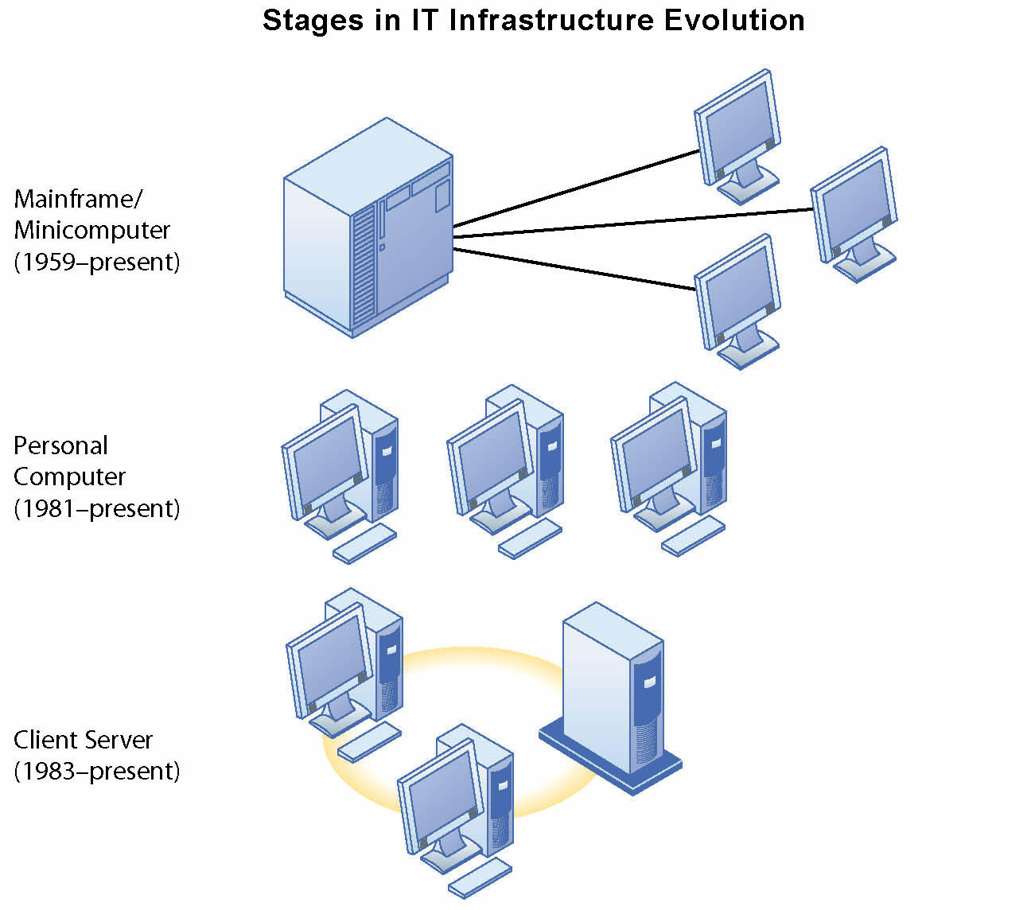
Eras in IT Infrastructure Evolution
Illustrated here are the first three typical computing configurations characterizing each of the five eras of IT infrastructure evolution.

Slide 9
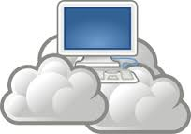
Eras in IT Infrastructure Evolution (contd.)
Evolution of IT infrastructure (cont.)
Enterprise Internet computing era: 1992 to present
Move toward integrating disparate networks, applications using Internet standards and enterprise applications
Cloud Computing: 2000 to present
Refers to a model of computing where firms and individuals obtain computing power and software applications over the Internet
Fastest growing form of computing

Slide 10
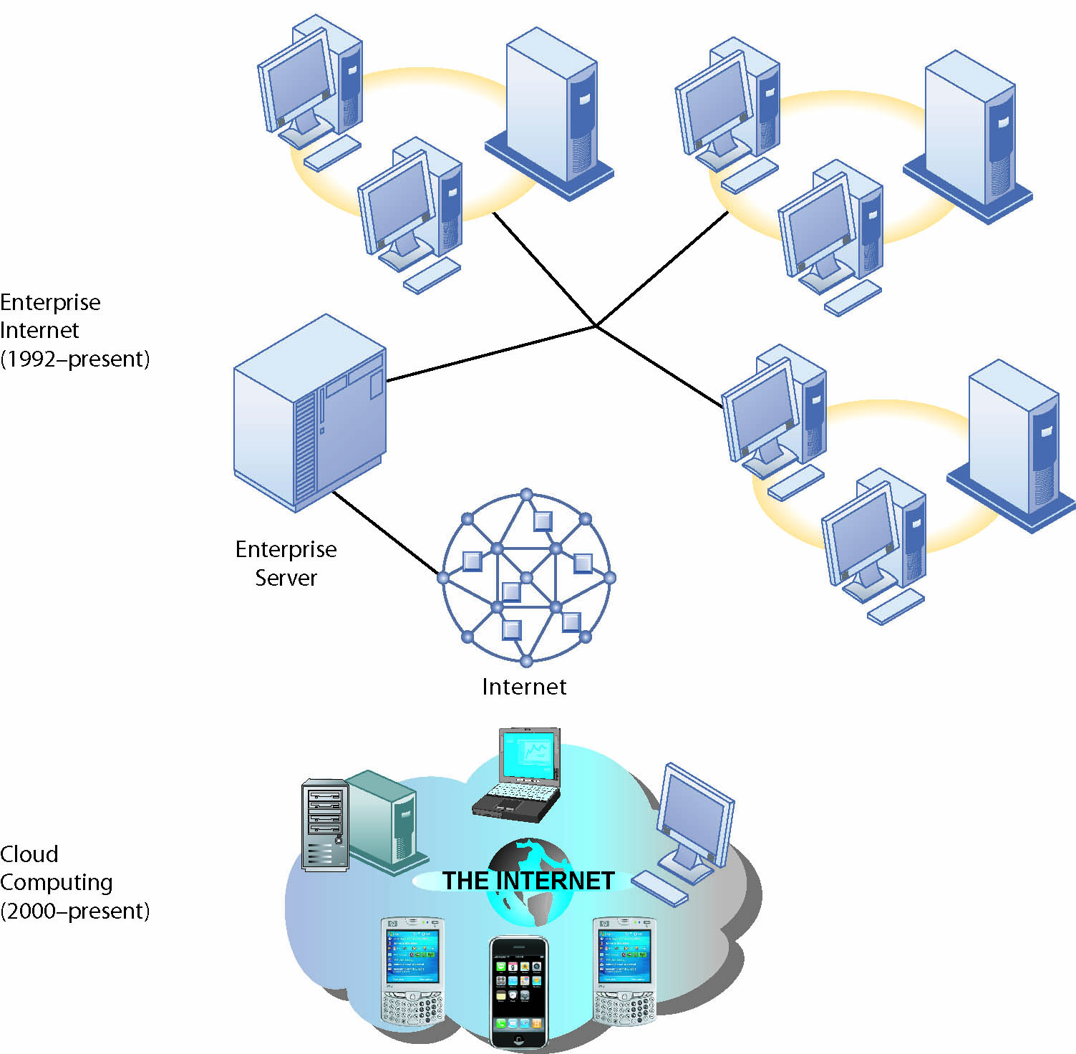
Eras in IT Infrastructure Evolution (cont)
Illustrated here are the fourth and fifth typical computing configurations characterizing each of the five eras of IT infrastructure evolution.

Slide 11
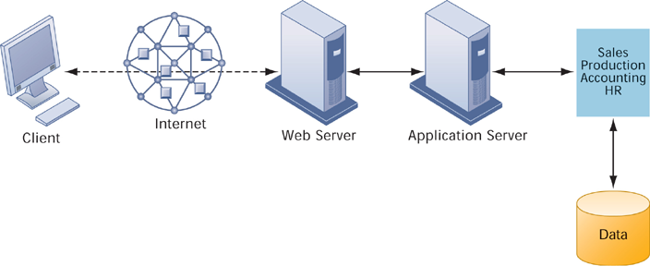
A Multitiered Client/Server Network (N-Tier)
In a multitiered client/server network, client requests for service are handled by different levels of servers.

Slide 12
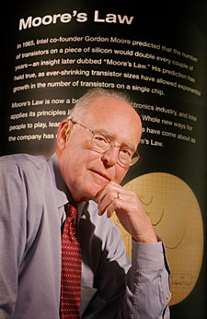
Technology drivers of infrastructure evolution
Moore’s law and microprocessing power
Computing power doubles every 18 months
Nanotechnology: May shrink size of transistors to width of several atoms
Contrary factors: Heat dissipation needs, power consumption concerns
Law of Mass Digital Storage
The amount of data being stored each year doubles
Gordon E. Moore, Co-founder, Intel Corporation

Slide 13
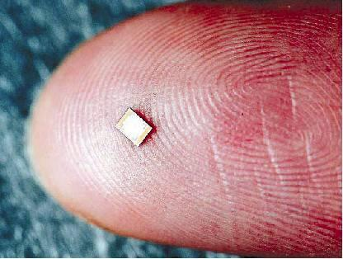
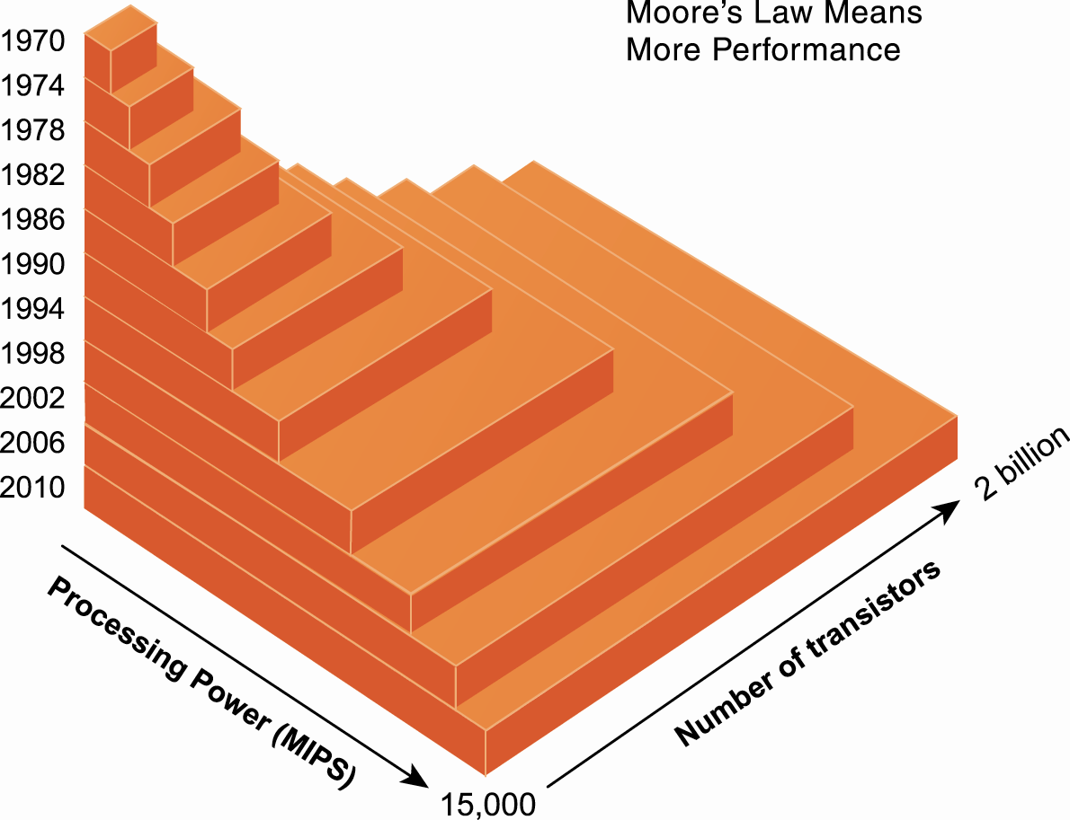
Moore’s Law and Microprocessor Performance
Packing more transistors into a tiny microprocessor has exponentially increased processing power.

Slide 14
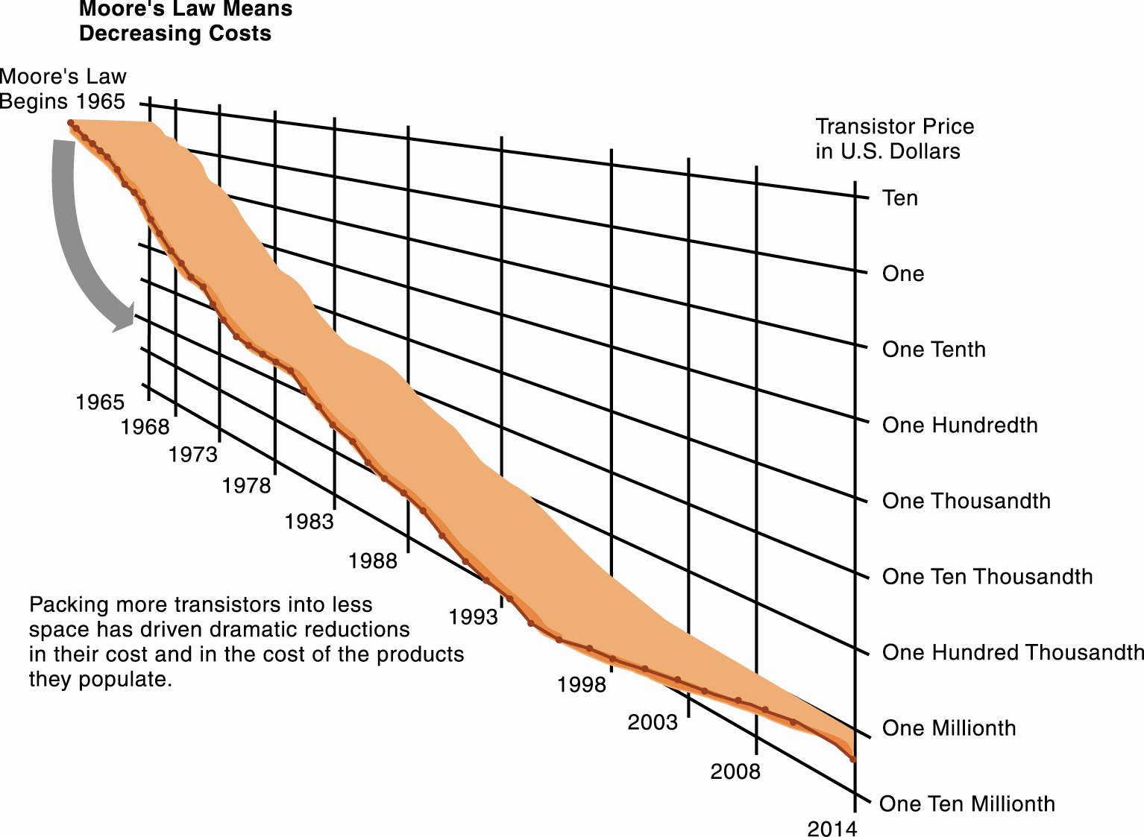
Falling Cost of Chips
An Intel® processor today can contain as many as 1 billion transistors, run at 3.2 GHz and higher, deliver over 10,000 MIPS, and can be manufactured in high volumes with transistors that cost less than 1/10,000th of a cent. That’s a little less than the cost of one printed character in course book.

Slide 15
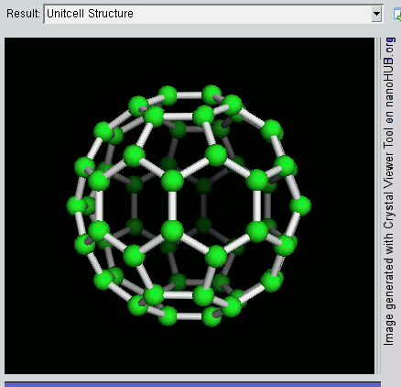
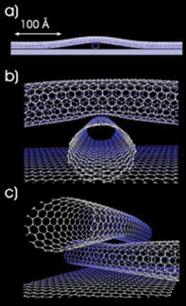
Nanotechnology - Examples of Nanotubes
Nanotubes are tiny tubes about 10,000 times thinner than a human hair. They consist of rolled up sheets of carbon hexagons. Discovered in 1991 by researchers at NEC, they have the potential uses as minuscule wires or in ultrasmall electronic devices and are very powerful conductors of electrical current.

Slide 16
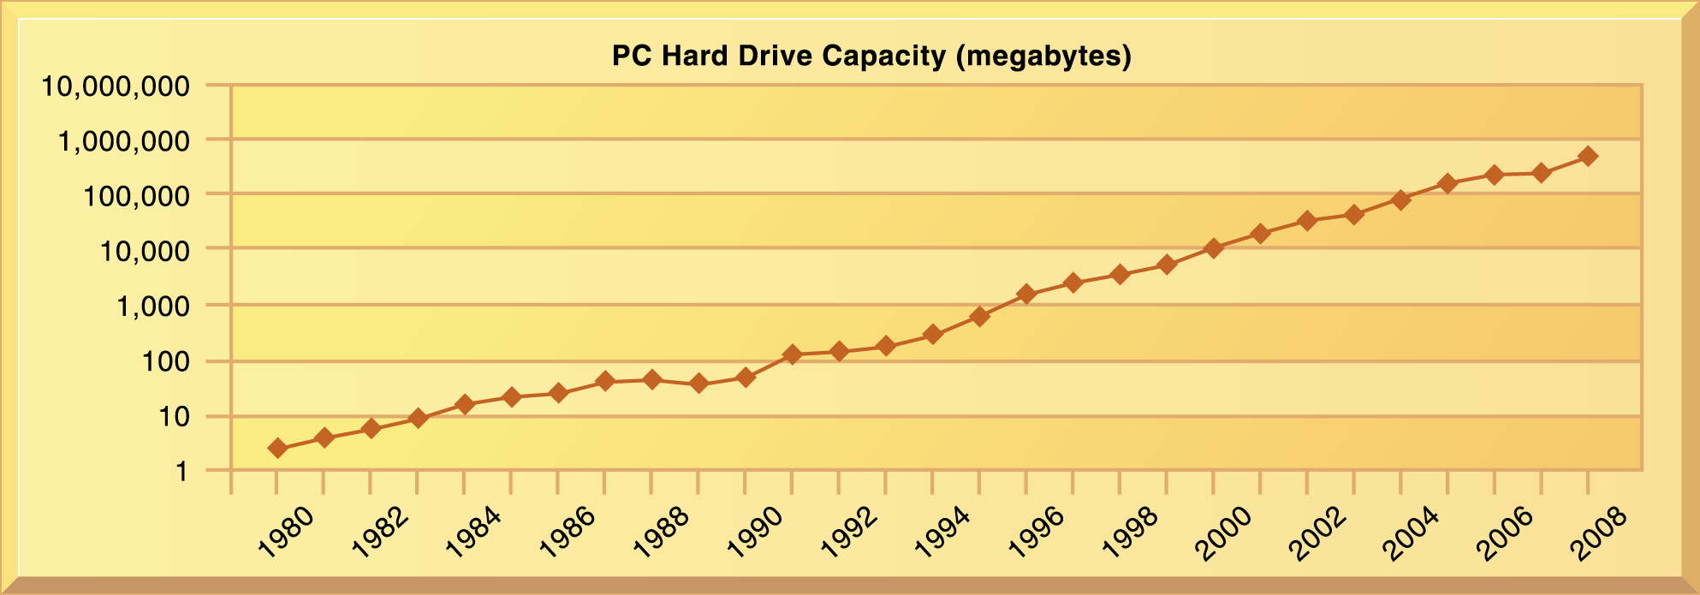
The Capacity of Hard Drives Grows Exponentially 1980-2007
From 1980 to 1990, hard disk drive capacities for PCs grew at the rate of 25 percent annual compound growth, but after 1990, growth accelerated to more than 65 percent each year.

Slide 17
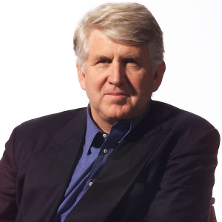
Technology drivers of infrastructure evolution (cont.)
Metcalfe’s Law and network economics
Value or power of a network grows exponentially as a function of the number of network members
As network members increase, more people want to use it (demand for network access increases)
Robert Metcalfe

Slide 18
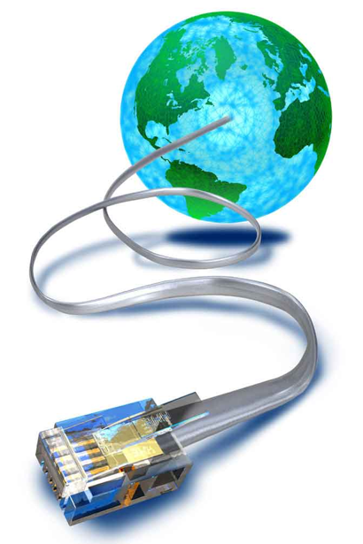
An estimated 1.5 billion people worldwide have Internet access
As communication costs fall toward a very small number and approach 0, utilization of communication and computing facilities explodes

Slide 19
Technology drivers of infrastructure evolution (cont.)
Standards and network effects
Technology standards:
Specifications that establish the compatibility of products and the ability to communicate in a network
Unleash powerful economies of scale and result in price declines as manufacturers focus on the products built to a single standard
COBOL
Ethernet
ASCII
WWW
Unix
TCP/IP
PC

Slide 20

E xercise 1 – Video time
The evolution of Computers:
When was the first computers developed?
What was the first Foley working computer called?
The first computer developed in the united states was called?
What reduced the size of computers?
Who developed the first disk drive and what year?
What was the name of the first operating system introduced?
When was the first Microprocessor developed?
What was the first Microprocessor called?
What was the first personal computer called?
Name two of the most popular computers first introduced?
Outline 2 significant differences that computers have now from the first ones introduced?

Slide 21

Break Time
10 Minutes break!!

Slide 22
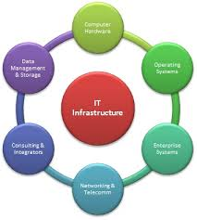
IT Infrastructure Ecosystem
There are seven major components that must be coordinated to provide the firm with a coherent IT infrastructure
Laudon & Laudon

Slide 23
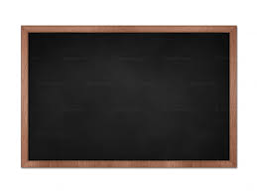
IT Infrastructure’s 7 main components
Computer hardware platforms
Operating system platforms
Enterprise software applications
Data management and storage
Networking/telecommunications platforms
Internet platforms
Consulting system integration services

Slide 24
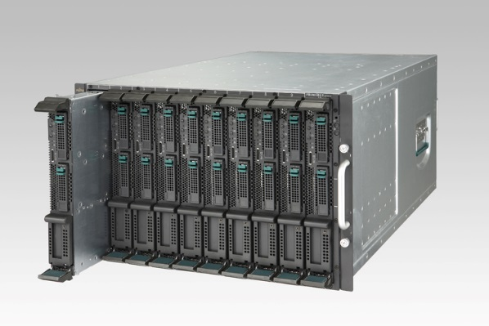
1. Computer hardware platforms
Client machines
Desktop PCs, mobile computing devices – PDAs, laptops
Servers
Blade servers: ultrathin computers stored in racks
Mainframes:
IBM mainframe equivalent to thousands of blade servers
Top chip producers: AMD, Intel, IBM
Top firms: IBM, HP, Dell, Sun Microsystems

Slide 25
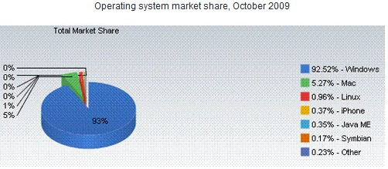
2. Operating system platforms
Operating system platforms
Operating systems
Client level: 95% run Microsoft Windows (7, Vista, XP, etc.)
Server level: 85% run Unix or Linux

Slide 26
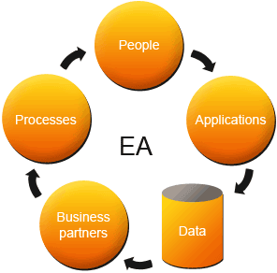
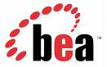

3. Enterprise software applications
Enterprise software applications
Enterprise software applications
Enterprise application providers: SAP and Oracle
Middleware providers: BEA

Slide 27
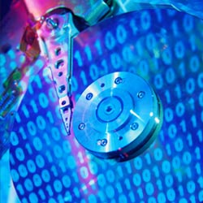
4. Data management and storage
Data management and storage
Database software:
IBM (DB2)
Oracle
Microsoft (SQL Server)
Sybase (Adaptive Server Enterprise)
MySQL
Physical data storage: EMC Corp (large-scale systems), Seagate, Maxtor, Western Digital
Storage area networks: connect multiple storage devices on dedicated network

Slide 28
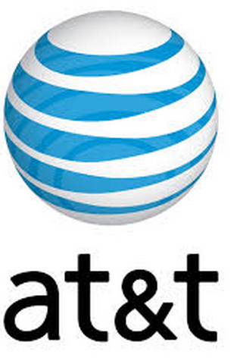
5. Networking/telecommunications platforms
Networking/telecommunications platforms
Telecommunication services
Telecommunications, cable, telephone company charges for voice lines and Internet access
AT&T, Verizon
Network operating systems:
Windows Server, Novell, Linux, Unix
Network hardware providers: Cisco, Lucent, Nortel, Juniper Networks

Slide 29
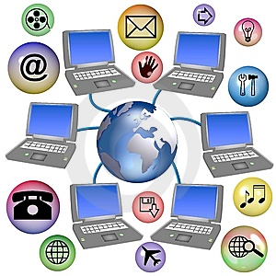
6. Internet platforms
Internet platforms
Hardware, software, management services to support company Web sites, (including Web hosting services) intranets, extranets
Internet hardware server market: Dell, HP/Compaq, IBM
Web development tools/suites: Microsoft (FrontPage, .NET) IBM (WebSphere) Sun (Java)
Independent software developers: Macromedia/Adobe, RealMedia

Slide 30

7. Consulting and system integration services
Consulting and system integration services
Even large firms do not have resources for full range of support for new, complex infrastructure
Software integration: ensuring new infrastructure works with legacy systems
Legacy systems: older TPS created for mainframes that would be too costly to replace or redesign
Accenture, IBM Global Services, EDS, Infosys, Wipro

Slide 31
E xercise 2 – Group Activity
HANDOUT
In groups of two, write down examples of the 7 components of an IT Infrastructure
Give 3 examples of each
Internet platforms
Computer Hardware Platforms
Operating Systems
Enterprise Software Applications
Networking Telecommunications
Consultants and system Integrators
Data Management and Storage

Slide 32
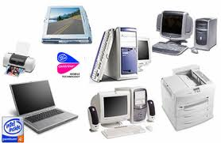
Contemporary Hardware Platform Trends
The Emerging Mobile Digital Platform
Grid Computing
Autonomic Computing
Cloud Computing
Virtualization and Multicore processors

Slide 33
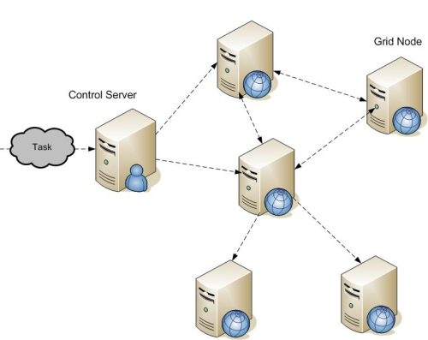
Grid computing
Grid computing
Connects geographically remote computers into a single network to combine processing power and create virtual supercomputer
Provides cost savings, speed, agility
Typical Grid Farm

Slide 34
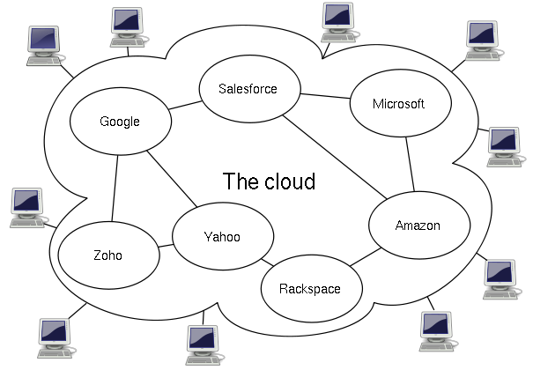
Cloud computing
Cloud computing (utility computing)
Data permanently stored in remote servers, accessed and updated over the Internet by users
Organizations using cloud computing need only pay for the computing power they actually use (on-demand or utility computing)
Cloud Computing Logical Diagram

Slide 35
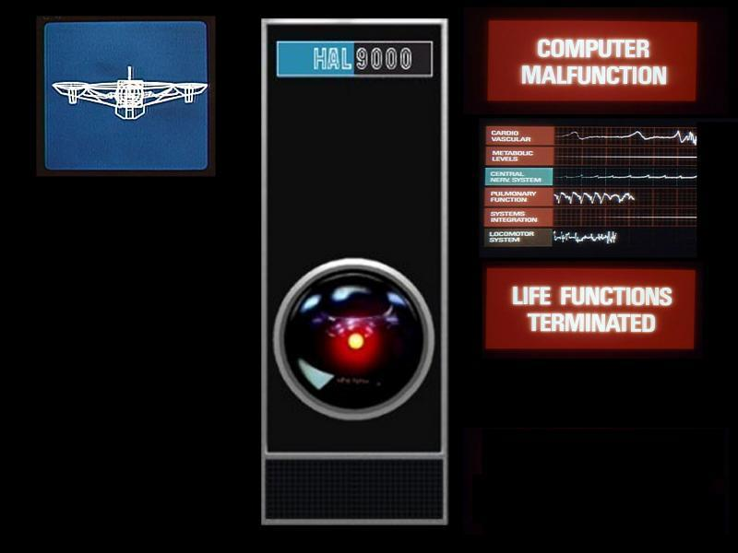
Autonomic computing
Autonomic computing
Industry-wide effort to develop systems that can configure, optimize themselves, heal themselves when broken, and protect themselves from outside intruders
Similar to self-updating antivirus software; Apple and Microsoft both use automatic updates

Slide 36
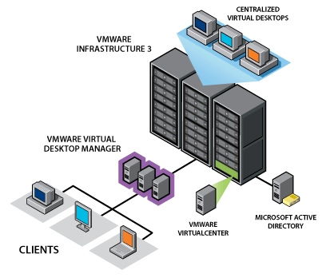
Virtualization
Virtualization
Virtualization: presents computing resources so that they can be accessed in ways that are not restricted by configuration
Allows multiple operating systems to run on one machine; increases server utilization rates from 10-15 to 70 percent of capacity

Slide 37
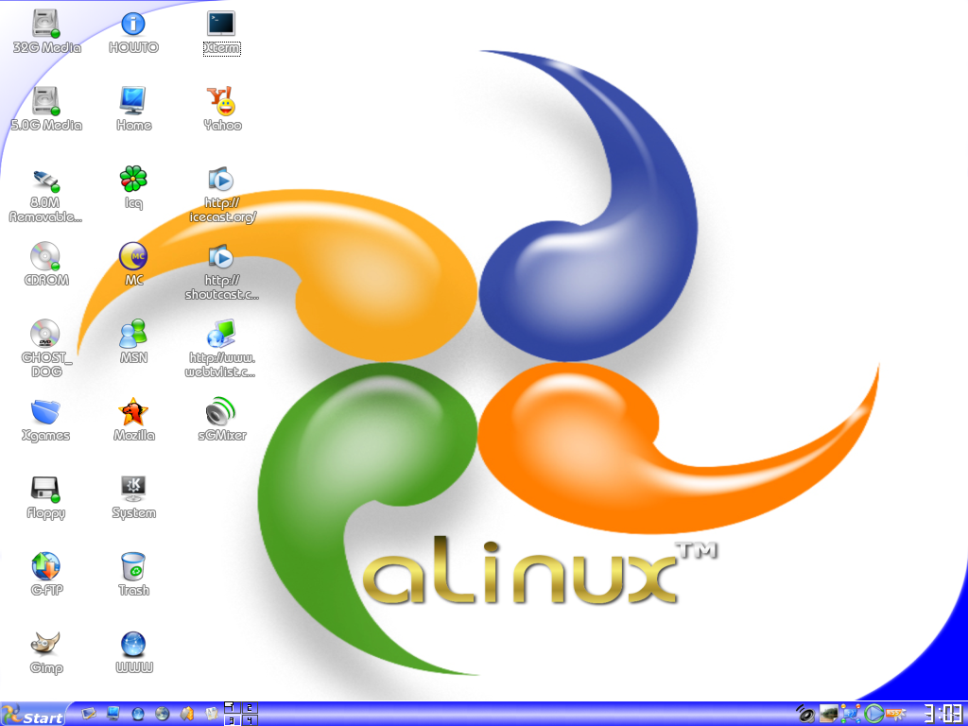

Open-source Software
Linux and open-source software
Open-source software
Produced by community of programmers
Free
Modifiable by user

Slide 38
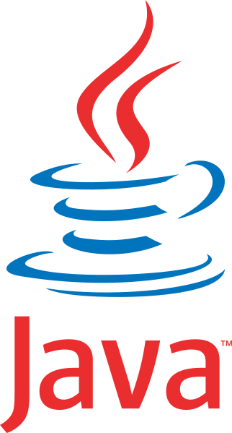

Software for the Web
Java
Object-oriented programming language (Sun Microsystems)
Operating system, processor-independent (Java Virtual Machine)
Leading programming environment for Web
Applets, E-commerce applications
Ajax
Asynchronous JavaScript and XML
Allows client and server to exchange small pieces of data without requiring the page to be reloaded
EG – map sites

Slide 39
Web Services
Web Services
Software components that exchange information using Web standards and languages
XML: Extensible Markup Language
More powerful and flexible than HTML
Tagging allows computers to process data automatically
SOAP: Simple Object Access Protocol
Rules for structuring messages enabling applications to pass data and instructions
WSDL: Web Services Description Language
Framework for describing Web service and capabilities
UDDI: Universal Description, Discovery, and Integration
Directory for locating Web services

Slide 40
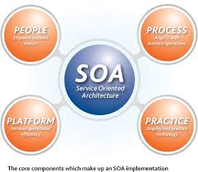
SOA (Service Oriented Architecture)
SOA (Service Oriented Architecture)
A form of ‘distributed’ computing
An application on one machine can access a ‘service’ on another machine to obtain business information or make a business transaction
Thanks to its use of Industry Standards SOA supports the integration of heterogeneous IT systems, which has always been a challenge
In theory new applications can be created more quickly through the re-use of existing ‘services’

Slide 41
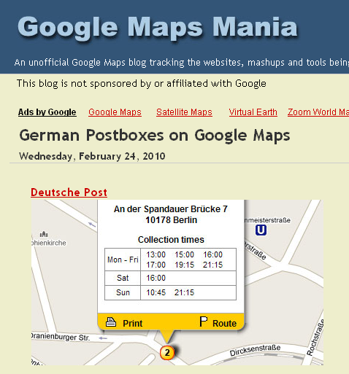
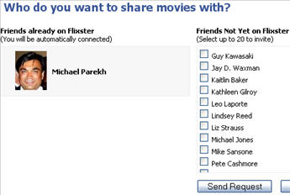
Mashups and widgets
Mashups
Combinations of two or more online applications, such as combining mapping software (Google Maps) with local content
Widgets
Small programs that can be added to Web pages or placed on the desktop to add additional functionality
EG – Flixter widget on Facebook

Slide 42
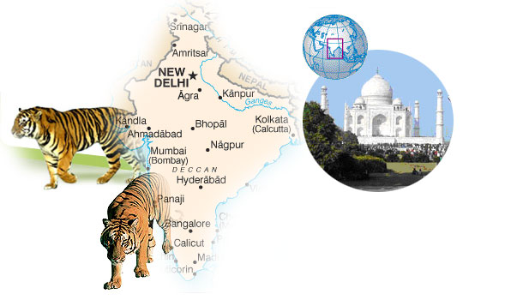
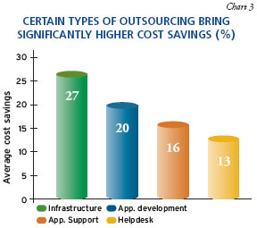
Outsourcing
Software outsourcing
Three sources
External commercial vendor
Online service providers
Offshore firms
Software packages
Pre-written set of software available commercially
Software as a service (SaaS):
Software delivered over the Internet
Offshore outsourcing:
Usually governed by service level agreement

Slide 43
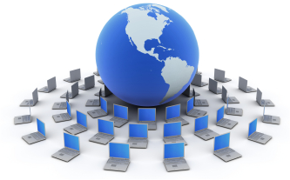
Management Issues
Dealing with platform and infrastructure change
As firms shrink or grow, IT needs to be flexible and scalable
How does firm remain flexible and still make long term investments?
Scalability:
Ability to expand to serve larger number of users
Firms using mobile computing and cloud computing require new policies and procedures for managing these new platforms
Contractual agreements with firms running clouds and distributing software required

Slide 44
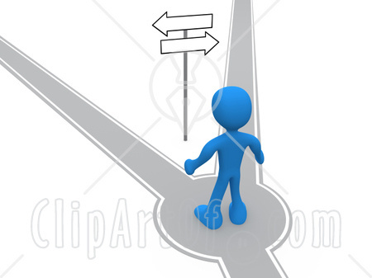
Rent or Buy?
Making wise infrastructure investments
Amount to spend on IT is complex question
Rent vs. buy
Essentially, do you want to tie up capital upfront or spread it out (at some additional capital cost)?
Do you really want to own that gadget/box/application?
What will its depreciation curve look like given how rapidly the industry is moving?
How long will it be before you see the dreaded "End Of Life" notes on the web pages associated with the products you buy today?
How long before disk replaces tape?
How long before solid state memory replaces disk?
How long before VGA devices are legacy? USB?

Slide 45

Investments – How much?
Competitive forces model for IT infrastructure investment
How much should your our firm spend on IT infrastructure?
Market demand for firm’s services
Firm’s business strategy
Firm’s IT strategy, infrastructure, and cost
Information technology assessment
Competitor firm services
Competitor firm IT infrastructure investments

Slide 46
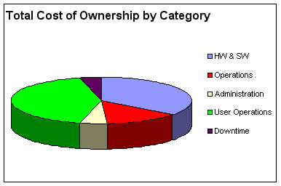
TCO
Total Cost of Ownership of Technology Assets
TCO model: Used to analyze direct and indirect costs of systems
Hardware, software account for only about 20%-30% of TCO
Other costs include: Installation, training, support, maintenance, infrastructure, downtime, space and energy
TCO can be reduced through greater centralization and standardization of hardware and software resources

Slide 47
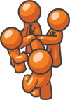
E xercise 3 – Question Time
Define the following terms:
Cloud Computing
Autonomic computing
Virtualization
Grid Computing
Outsourcing
SOA
TCO
Individual work

Slide 48

RECAP
To gain an understanding of the following:
Define IT infrastructure and describe its components.
Identify and describe the stages and technology drivers of IT infrastructure evolution.
Assess contemporary computer hardware platform trends.
Assess contemporary software platform trends.
Evaluate the challenges of managing IT infrastructure and management solutions.

